Slide 1
Gaussian Blur Different Parallel Platforms Comparison
Group No. 24
0756031 資工所 李鴻暘
0416324 資工系 胡安鳳
0416024 資工系 陳羿豐

Slide 2
Outline
Gaussian Blur explained.
Motivation.
Hardware for this project
Parallelization platform animation.
Different platforms explained and respective discoveries .
CUDA
OpenCL
OpenMP
Demo video.
Q&A

Slide 3
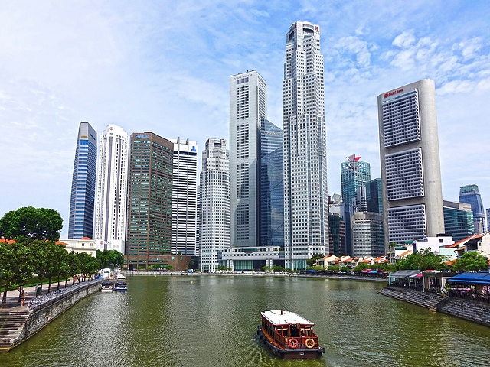

What is Gaussian Blur and why need?
An image processing algorithm using convolution to smooth images.
Result images varies with filter size and standard deviation of Gaussian Kernel.
Such algorithm can be used for noise reduction of the image.
Time complexity is O(img_width x img_height x filter_size^2)
640 x 480
filter size 101 x 101
stddev 10

Slide 4
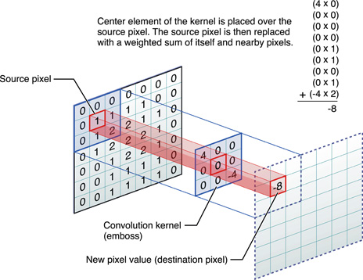
Motivation of this project
Widely used algorithm in lots of software like PhotoShop, GIMP.
Due to convolution, the compute complexity is extremely high.
Beside the well-known POSIX thread ,with an eye to try parallel on OpenMP where both computes with CPU.
Heterogeneous computation: Use more than one kind of processors, co-processing to gain significantly performance improvement such as CUDA and OpenCL
Gaussian Convolution with its kernel
Img source

Slide 5
Hardware for this project

Slide 6
標題及含圖表的內容版面配置

Slide 7
含表格的兩項內容版面配置
第一個項目符號
第二個項目符號
第三個項目符號
類別 | 群組 1 | 群組 2
類別 1 | 82 | 95
類別 2 | 76 | 88
類別 3 | 84 | 90

Slide 8
含 SmartArt 的兩項內容版面配置
第一個項目符號
第二個項目符號
第三個項目符號
工作 1
工作 2
工作 3

Slide 9
新增投影片標題 - 1

Slide 10
新增投影片標題 - 2

Slide 11
新增投影片標題 - 3

Slide 13
新增投影片標題 - 4

Slide 14
新增投影片標題 - 5

